Slide 1
Hydraulic Machinery
Pumps, Turbines...

Slide 2
Hydraulic Machinery Overview
Types of Pumps
Dimensionless Parameters for Turbomachines
Power requirements
Head-discharge curves
Pump Issues
Cavitation
NPSH
Priming
Pump selection

Slide 3
Types of Pumps
Positive displacement
piston pump
Diaphragm pump
peristaltic pump
Rotary pumps
gear pump
two-lobe rotary pump
screw pump
Jet pumps
Turbomachines
axial-flow (propeller pump)
radial-flow (centrifugal pump)
mixed-flow (both axial and radial flow)

Slide 4
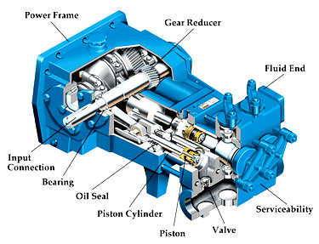
Reciprocating action pumps
Piston pump
can produce very high pressures
hydraulic fluid pump
high pressure water washers
diaphragm pump

Slide 5
Peristaltic Pump
Fluid only contacts tubing
Tubing ___ and roller _______ with respect to the tubing determine flow rate
Tubing eventually fails from fatigue and abrasion
Fluid may leak past roller at high pressures
Viscous fluids may be pumped more slowly
ID
velocity

Slide 6
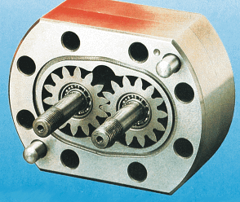
Rotary Pumps
Gear Pump
fluid is trapped between gear teeth and the housing
Two-lobe Rotary Pump
(gear pump with two “teeth” on each gear)
same principle as gear pump
fewer chambers - more extreme pulsation
trapped fluid

Slide 7
Rotary Pumps
Disadvantages
precise machining
abrasives wear surfaces rapidly
pulsating output
Uses
vacuum pumps
air compressors
hydraulic fluid pumps
food handling

Slide 8
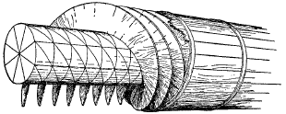
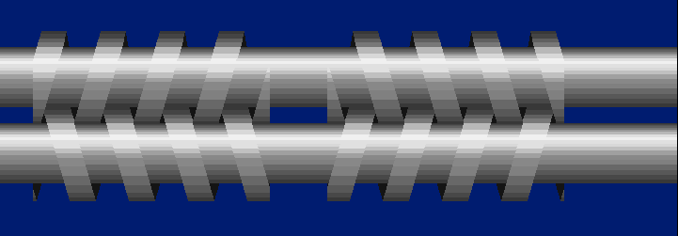
Screw Pump
Can handle debris
Used to raise the level of wastewater
Abrasive material will damage the seal between screw and the housing
Grain augers use the same principle

Slide 9
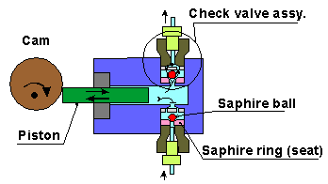
Positive Displacement Pumps
What happens if you close a valve on the effluent side of a positive displacement pump?
What does flow rate vs. time look like for a piston pump?
Thirsty Refugees

Slide 10

Jet Pump “eductor”
A high pressure, high velocity jet discharge is used to pump a larger volume of fluid.
Advantages
no moving parts
self priming
handles solids easily
Disadvantage
inefficient
Uses
deep well pumping
pumping water mixed with solids
http://spaceflight.nasa.gov/shuttle/upgrades/ojp.html

Slide 11
Turbomachines
Demour’s centrifugal pump - 1730
Theory
conservation of angular momentum
conversion of kinetic energy to potential energy in flow expansion ___________ ________
Pump components
rotating element - ___________
encloses the rotating element and seals the pressurized liquid inside - ________ or _________
(inefficient process)
impeller
casing
housing

Slide 12
Pressure Developed by Centrifugal Pumps
Centrifugal pumps accelerate a liquid
The maximum velocity reached is the velocity of the periphery of the impeller
The kinetic energy is converted into potential energy as the fluid leaves the pump
The potential energy developed is approximately equal to the ________ ____ at the periphery of the impeller
A given pump with a given impeller diameter and speed will raise a fluid to a certain height regardless of the fluid density
velocity head

Slide 13
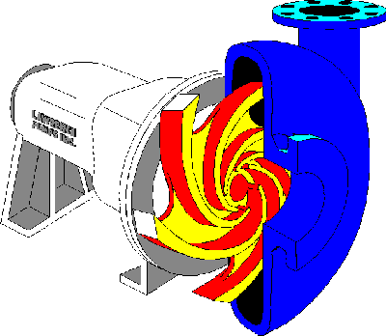
Radial Pumps
also called _________ pumps
broad range of applicable flows and heads
higher heads can be achieved by increasing the _______ or the ________ ______ of the impeller
centrifugal
diameter
rotational speed
Flow Expansion
Discharge
Casing
Suction Eye
Impeller
Impeller
Vanes

Slide 14
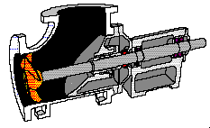
Axial Flow
also known as __________ pumps
low head (less than 12 m)
high flows (above 20 L/s)
propeller

Slide 15
Dimensionless Parameters for Turbomachines
We would like to be able to compare pumps with similar geometry. Dimensional analysis to the rescue...
To use the laws of similitude to compare performance of two pumps we need
exact geometric similitude
all linear dimensions must be scaled identically
roughness must scale
homologous - streamlines are similar
constant ratio of dynamic pressures at corresponding points
also known as kinematic similitude
same

Slide 16
Kinematic Similitude: Constant Force Ratio
Reynolds
ratio of inertial to _______ forces
Froude
ratio of inertial to ________ force
Weber
ratio of inertial to _______ ______ forces
Mach
ratio of inertial to _______ forces
viscous
gravity
surface-tension
elastic

Slide 17
Turbomachinery Parameters
Where is the fluid?
roughness
discharge
head
shape
impeller
(Impeller is better defined)

Slide 18
Shape Factor
Related to the ratio of flow passage diameter to impeller diameter
Defined for the point of best efficiency
What determines the ideal shape for a pump?
Exercise

Slide 19
Impeller Geometry: Shape Factor
*
Impeller diameter
N
S
pressure
flow
500
0.18
Radial: high _______, low ____
1000
0.37
radial
3400
1.25
mixed
6400
2.33
mixed
flow
pressure
axial: high _______, low _______
10000
3.67
*N in rpm, Q in gpm, H in ft
N_{sp} = 2732S

Slide 20
Use of Shape Factor: Specific Speed
The maximum efficiencies for all pumps occurs when the Shape Factor is close to 1!
Flow passage dimension is close to impeller diameter!
Low expansion losses!
There must be an optimal shape factor given a discharge and a head.
Shape factor defined for specific cases
Double suction
Treat like two pumps in parallel
Multistage (pumps in series)
Use Q and H for each stage
Why multistage?

Slide 21
Additional Dimensionless Parameters
D is the _______ diameter
impeller
P is the _____
power
Alternate equivalent way to calculate S.
(defined at max efficiency)

Slide 22
Head-Discharge Curve
Theoretical head-discharge curve
circulatory flow - inability of finite number of blades to guide flow
friction - ____
shock - incorrect angle of blade inlet ___
other losses
bearing friction
packing friction
disk friction
internal leakage
circulatory flow
V²
shock
friction
Actual head-discharge curve
shock
ΔV²
Q

Slide 23
Pump Power Requirements
Water power
Subscripts
w = _______
p = _______
s = _______
m = _______
water
pump
shaft
motor

Slide 24
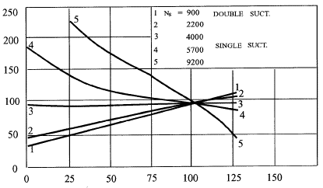
Impeller Shape vs. Power Curves
S
1 - O.33
2 - 0.81
3 - 1.5
4 - 2.1
5 - 3.4
radial
Power (% of design)
axial
Discharge (% of design)
Implications
http://www.mcnallyinstitute.com/

Slide 25
Affinity Laws
homologous
held constant
With diameter, D, held constant:
With speed, ω, held constant:

Slide 26
Dimensionless Performance Curves
0.08
1
Head
0.9
0.07
Efficiency
0.8
0.06
Efficiency
0.7
0.05
0.6
0.04
0.5
0.03
0.4
0.3
0.02
D=0.366 m
0.2
0.01
0.1
0
0
0
0.02
0.04
0.06
0.08
0.1
shape
Curves for a particular pump
____________ of the fluid!
(defined at max efficiency)
Independent

Slide 27
Pump Example
Given a pump with shape factor of 4.57, a diameter of 366 mm, a 2-m head, a speed of 600 rpm, and dimensionless performance curves (previous slide).
What will the discharge be?
How large a motor will be needed if motor efficiency is 95%?
Exercise

Slide 28
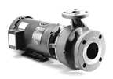
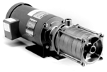
Pumps in Parallel or in Series
Parallel
Flow ________
Head ________
Series
Flow ________
Head ________
Multistage
adds
same
same
adds

Slide 29
Cavitation in Water Pumps
water vapor bubbles form when the pressure is less than the vapor pressure of water
very high pressures (800 MPa or 115,000 psi) develop when the vapor bubbles collapse

Slide 30
Net Positive Suction Head
NPSH_{R} - absolute pressure in excess of vapor pressure required at pump inlet to prevent cavitation
given by pump manufacturer
determined by the water velocity at the entrance to the pump impeller
NPSH_{A} - pressure in excess of vapor pressure available at pump inlet
determined by pump installation (elevation above reservoir, frictional losses, water temperature)
If NPSH_{A} is less than NPSH_{R} cavitation will occur

Slide 31
Net Positive Suction Head
2
Elevation datum
Absolute pressure
Δz
s = suction
Total head -p_{v}!
1
At cavitation!
NPSH_{R} increases with Q²!
How much total head in excess of vapor pressure is available?

Slide 32
NPSH_{A}
Subtract vapor pressure

Slide 33
NPSH_{r} Illustrated
P_{v}
Pressure in excess of vapor pressure required to prevent cavitation
NPSH_{r}
NPSH_{r} can exceed atmospheric pressure!

Slide 34
NPSH problem
Determine the minimum reservoir level relative to the pump centerline that will be acceptable. The NPSH_{r} for the pump is 2.5 m. Assume you have applied the energy equation and found a head loss of 0.5 m.
?
18°C
Exercise

Slide 35
Pumps in Pipe Systems
Pipe diameter is 0.4 m and friction factor is 0.015. What is the pump discharge?
60 m
1 km
1 m
1 m
often expressed as

Slide 36
Pumps in Pipe Systems
system operating point
120
100
80
system curve
Head vs. discharge
curve for ________
pump
60
Head (m)
Could you solve this with a dimensionless performance curve?
40
Static head
20
0
0
0.2
0.4
0.6
0.8
Discharge (m³/s)
What happens as the static head changes (a tank fills)?

Slide 37
Multistage Pump Curves 1
Efficiency
How could you plot a system curve on this graph given 3 stages?

Slide 38
Multistage Pump Curves 2
Efficiency
How could you plot a system curve on this graph given 3 stages?

Slide 39
Priming
The pressure increase created is proportional to the _______ of the fluid being pumped.
A pump designed for water will be unable to produce much pressure increase when pumping air
Density of air at sea level is __________
Change in pressure produced by pump is about 0.1% of design when pumping air rather than water!
density
1.225 kg/m³

Slide 40
Priming Solutions
Applications with water at less than atmospheric pressure on the suction side of the pump require a method to remove the air from the pump and the inlet piping
Solutions
foot valve
priming tank
vacuum source
self priming
priming tank
to vacuum pump
foot valve

Slide 41
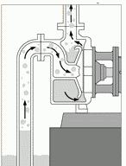
Self-Priming Centrifugal Pumps
Require a small volume of liquid in the pump
Recirculate this liquid and entrain air from the suction side of the pump
The entrained air is separated from the liquid and discharged in the pressure side of the pump

Slide 42
Variable Flows?
How can you obtain a wide range of flows?
__________________________
__________________________
__________________________
__________________________
__________________________
Why is the flow from two identical pumps usually less than the 2x the flow from one pump?
Valve
Multiple pumps (same size)
Multiple pumps (different sizes)
Variable speed motor
Storage tank

Slide 43
RPM for Pumps
60 cycle
Other options
variable speed
belt drive

Slide 44
Estimate of Pump rpm
The best efficiency is obtained when S=1
Given a desired flow and head the approximate pump rpm can be estimated!
Pump for flume in DeFrees Teaching Lab…
Q = 0.1 m³/s, h_{p} = 4 m.
Therefore ω = 50 rads/s = 470 rpm
Actual maximum rpm is 600!

Slide 45
Pump Selection
Material Compatibility
Solids
Flow
Head
NPSH_{a}
Pump Selection software
A finite number of pumps will come close to meeting the specifications!

Slide 46
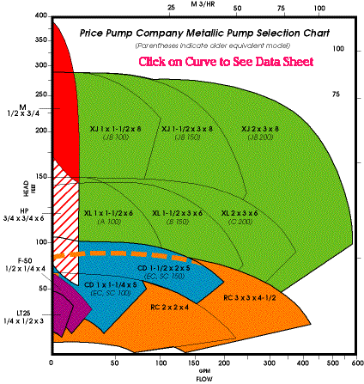
Pump Selection Chart
http://www.pricepump.com/
Model M
Model X

Slide 47
End of Curve Operation
Right of the BEP (Best Efficiency Point)
is sufficient NPSH available for the pump to operate properly?
fluid velocities through the suction and discharge nozzles of the pump could be extremely high, resulting in increased pump and system noise (and wear)
Left of BEP operation
high thrust loads on the pump bearings and mechanical face seals result in premature failure.
The pump is oversized, resulting in lower efficiency and higher operating and capital costs.

Slide 48
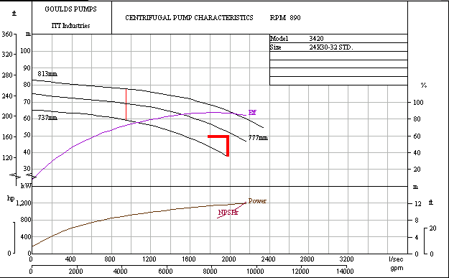
Gould’s Pump Curves
890 rpm = 93.2 rad/s
Splitcase double suction
BEP = 1836 L/s
S=0.787
Check the Power!

Slide 49
Pump Installation Design
Why not use one big pump?
Can the system handle a power failure?
Can the pump be shut down for maintenance?
How is the pump primed?
Are there enough valves so the pump can be removed for service without disabling the system?

Slide 50
Pump Summary
Positive displacement vs. turbomachines
Dimensional analysis
Useful for scaling
Useful for characterizing full range of pump performance from relatively few data points
Turbomachines convert shaft work into increased pressure (or vice versa for turbines)
The operating point is determined by where the pump and system curves intersect
NPSH

Slide 51
Water problem?
Early in my college days I took a break and spent 17 months in Salvadoran refugee camps in Honduras. The refugee camps were located high in the mountains and for several of the camps the only sources of water large enough to sustain the population of 6-10,000 were located at much lower elevations. So it was necessary to lift water to the camps using pumps.
When I arrived at the camps the pumps were failing frequently and the pipes were bursting frequently. Piston pumps were used. The refugees were complaining because they needed water. The Honduran army battalion was nervous because they didn’t want any refugees leaving the camp. There was only one set of spare parts (valve springs and valves) for the pump and the last set of parts only lasted a few days. The pump repair crew didn’t want to start using the pump until the real cause of the problem was fixed because spare parts have to be flown in from Miami.

Slide 52

Water in Colomoncagua

Slide 53

Waiting for water

Slide 54
Water problem: proposed solutions?
2 km pipeline (2” galvanized and then 3” PVC) with rise of 100 m
piston pump (80 L/min)

Slide 55
Shape Factor Solution
Create a dimensionless grouping
mass
Eliminate ______
length
Eliminate _______
time
Eliminate ______

Slide 56
Pump Curve Solution

Slide 57
Pump Curve Solution
0.08
1
0.07
0.9
0.8
0.06
Efficiency
0.7
0.05
0.6
0.04
0.5
0.03
0.4
0.3
0.02
D=0.366 m
0.2
0.01
0.1
0
0
0
0.02
0.04
0.06
0.08
0.1

Slide 58
NPSH solution
?
18°C

Slide 59
Implications of Power Curves
You are going to start a radial flow pump powered by an electric motor. You want to reduce the starting load on the motor. What can you do?
What would you do if you were starting an axial flow pump?
How could reducing the head on a radial flow pump result in motor failure?
Close the effluent valve
Open the effluent valve
An effluent pipe break would increase the flow and increase the power requirement

Slide 60
Find Q
Let A = 10 cm²
work
Dimensional analysis
Datum is reservoir level
Neglect head loss

Slide 61
How could we lift water more efficiently?
Shaft work added
Potential energy
Kinetic energy
cs₂
v_{t}
ω
Solve for Q=AV
r
Decrease V without decreasing Q! (

Slide 62
Lost energy

Slide 64
Reflections
Can EGL rise in direction of flow?
Can HGL rise in direction of flow?
In the rough pipe region, if the pipe diameter is doubled what does the head loss do?
How is air removed from a pipeline?

